Slide 1
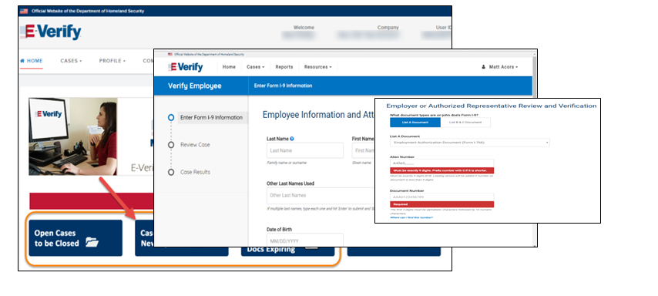
E-Verify Overview Webinar
www.E-Verify.gov

Slide 2
Disclaimer
This presentation is intended for E-Verify employers and their designated agents. This presentation provides basic guidance about the rules and responsibilities during the employment eligibility verification process. For more information visit the e-verify.gov website.
This presentation is not intended for members of the media. For all media inquires visit the U.S. Citizenship and Immigration Services Media Contacts webpage.

Slide 3
What is E-Verify?
Free web-based service that’s fast and easy to use
Electronically verifies the employment eligibility of newly hired employees
Existing employees assigned to work on a qualifying federal contract *
Partnership between the U.S. Department of Homeland Security (DHS) and the Social Security Administration (SSA)
*Contract that includes the E-Verify Federal Acquisition Regulation (FAR) clause.

Slide 4
State E-Verify Requirements

Slide 5
Form I-9 Process with E-Verify
All employees of E-Verify employers MUST
Provide Social Security number (SSN) on Form I-9
Select List B documents with photo, if provided for Form I-9
All E-Verify employers MUST
Use completed Form I-9
Create E-Verify case by 3rd business day after 1st day of work for pay
Enter employee e-mail address into E-Verify, if provided for Form I-9
Keep copy of photo matching document, if provided
Reverify in Section 3 of Form I-9 only; do not create additional E-Verify case

Slide 6
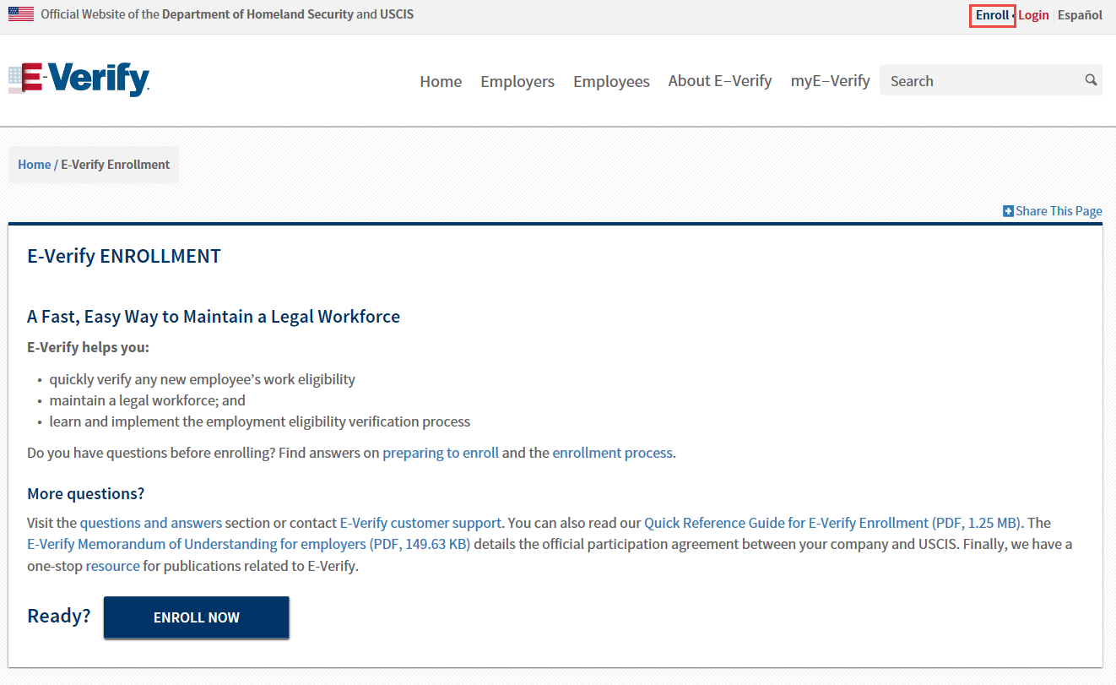
How to Enroll

Slide 7
Access Methods

Slide 8
User Roles
User Role | Permissions
Program Administrator (at least one required) | The program administrator is responsible for following all E-Verify program rules and staying informed of changes to E-Verify policies and procedures.
General User | Employers can have as many or no general users as they desire. The general user is responsible for following all E-Verify program rules and staying informed of changes to E-Verify policies and procedures.

Slide 9
Display Posters
Employers Must
Display E-Verify participation poster
Display You Have Rights posters
Contact Immigrant and Employee Rights (IER) with questions regarding discrimination: 1-800-255-8155 (TDD: 1-800-362-2735

Slide 10
Form I-9 & E-Verify Work Together

Slide 11
E-Verify Case Processing Biographic

Slide 12
E-Verify Case Processing E-mail Address

Slide 13
E-Verify Case Processing Attestation and Documents

Slide 14
Photo Match
Allows you to match the photo on a document to the photo that DHS has on file for that employee, and is activated automatically if an employee has presented:
I-551, (Permanent Resident Card)
Form I-766, (Employment Authorization Document), or
U.S. passport or passport card

Slide 15
What is myE-Verify?
myE-Verify is a free web-based service for employees to participate in the E-Verify process.
Access Self Check to confirm your work eligibility
Create a myE-Verify account
Protect your identity
Learn about your individual rights
myE-Verify Case Tracker

