Slide 1
Form I-9 Mistakes Big or Small…. Avoid them All!!
Dave Basham

Slide 2
Immigrant and Employee Rights Section (IER)
The anti-discrimination provisions of the INA are enforced by:
Department of Justice Civil Rights Division
Immigrant and Employee Rights Section
Employees may contact the Immigrant and Employee Rights Section (IER) to obtain additional information regarding employment discrimination and employee rights and responsibilities*
1-800-255-7688 (TDD: 1-800-616-5525)
Employers may also contact IER*
1-800-255-8155 (TDD: 1-800-362-2735)
*callers may remain anonymous
See IER’s “Employer Dos and Don’ts.”

Slide 3
Form I-9 Requirements
All U.S. employers must have a Form I-9 on file for all current employees.
The revised form has a revision date of July 17, 2017N. As of September 18, 2017, employers must use this revised form for all newly hired employees and any necessary reverification.
Exception: Employers are not required to have Forms I-9 for employees hired on or before November 6, 1986.
You may delegate the authority to complete Form I-9 to a responsible agent, however, you will retain liability for any errors.

Slide 4
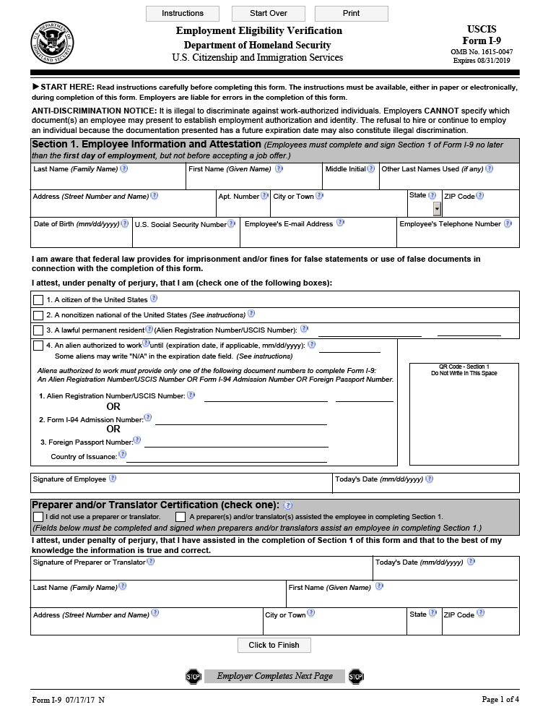
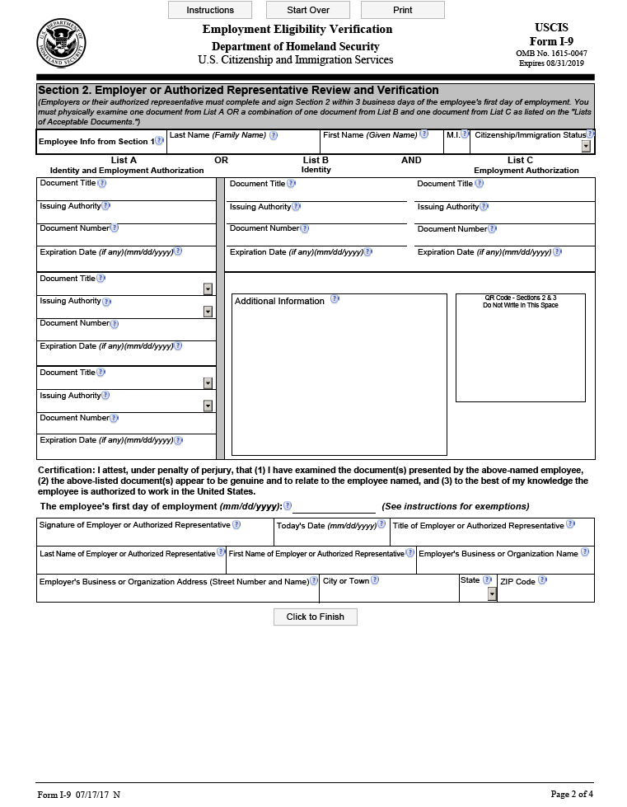
Completing Form I-9

Slide 5
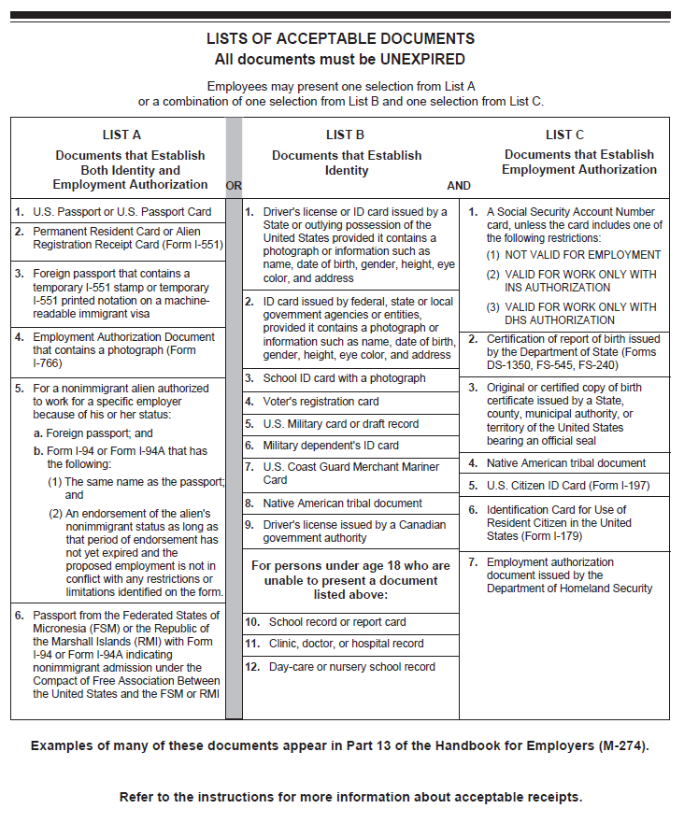
Lists of Acceptable Documents
Use MOST CURRENT Form I-9 VERSION, 07/17/17 N
You must make the Lists of Acceptable Documents available to your EMPLOYEE when he or she is completing the Form I-9
The EMPLOYEE MUST provide:
One document from List A
OR
One document from List B AND one document from List C

Slide 6
Section 1: Employee Information
To be completed by EMPLOYEE.
Employer MUST verify Section 1 is COMPLETE.

Slide 7
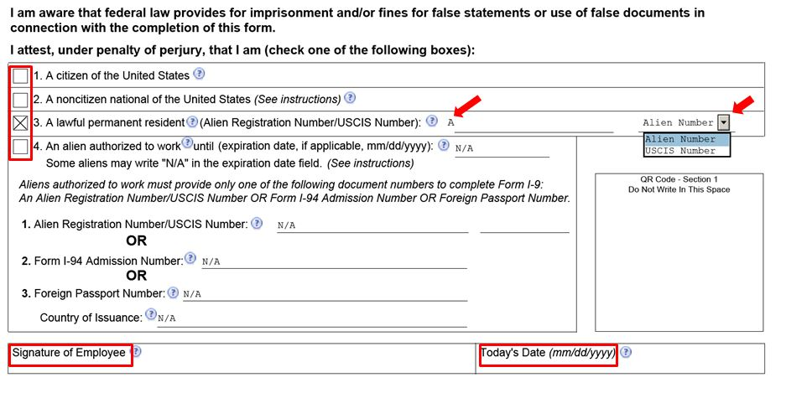
Section 1: Employee Attestation
The EMPLOYEE MUST select one of the four categories and sign and date Section 1 of Form I-9.
All employees must complete Section 1 no later than the first business day of employment for pay.

Slide 8
Section 1: Preparer/Translator (P/T) Certification
Required when Section 1 is prepared by someone other than the employee.
Employees must:
Check the first box if they don’t use a preparer or translator. No entries can be made in the fields as the check box is equivalent to stating N/A.
Check the second box if they use a P/T, then choose from the drop-down menu the number of preparers and translators used.

Slide 9
Section 2 Employer Certification of Document Review
Completed by EMPLOYER.
MUST be completed no later than 3 business days after the employee begins 1st day of work for pay.
EMPLOYER MUST examine original documents in presence of employee.
Documents MUST be UNEXPIRED.

Slide 10
Section 2: Examining Documents
You are not required to be a document expert
You MUST accept a document presented by an employee if it:
Reasonably appears to be genuine; AND,
Relates to the individual presenting it
The document MUST be original* – photocopies are NOT acceptable
*Exception: Certified copy of a birth certificate

Slide 11
Section 2: Copying Documents
You may choose to make copies of employee documentation presented to you for Section 2.
If you choose to photocopy documents, you must do so for ALL employees, regardless of actual or perceived national origin, immigration or citizenship status, or you may be in violation of anti-discrimination laws.

Slide 12
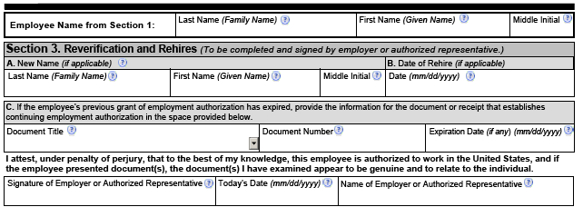
Section 3: Reverification & Rehires
You MUST reverify an employee using Section 3 if his or her temporary employment authorization has expired.
You MAY also complete Section 3 if you:
Rehire the EMPLOYEE within 3 years of the date of initial execution of the Form I-9*
Update the biographic information of an employee
* USCIS recommends completing a new Form I-9 for rehires

Slide 13
Section 3: When to Reverify

Slide 14
Correcting Form I-9
Correcting Mistakes
If you discover a mistake on Form I-9, correct the existing form OR prepare a new Form I-9:
If you choose to correct the existing Form I-9, line out the incorrect portions, enter the correct information, and initial and date the correction.
If you do a new Form I-9, retain the old form. You should also attach a short memo to both the new and old Forms I-9 stating the reason for your action.
Missing Forms
If you discover you are missing the Form I-9 for an employee:
Provide the employee with a Form I-9
Complete the Form I-9 as soon as possible
DO NOT backdate the Form I-9.

Slide 15
Retention
Forms I-9 must be retained for:
3 years after the date you hire an employee; or,
1 year after the date employment terminates, whichever is later.
Example:
John was hired on November 1, 2017, and terminated on July 5, 2018

Slide 16
Resources

Slide 17
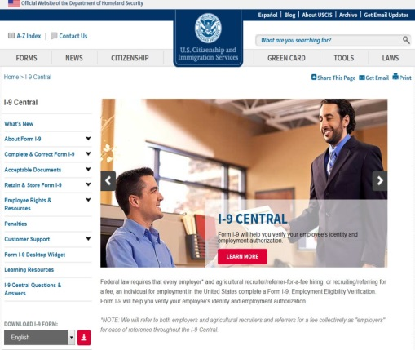
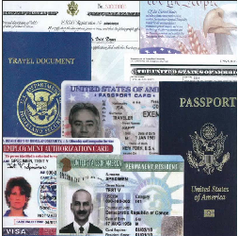
Form I-9 Resources
I-9 Central
I-9 Central
Office of Citizenship
I-9Central/Espanol (Spanish)
M-274, Handbook for Employers
Mergers & Acquisitions
Free Customized Webinars
Examples of documents:
Acceptable Documents
Additional Documentation Requirements
I-9 Webinar on Demand & Vignettes

Slide 18
Customer Service
E-Verify received one of the highest customer service ratings among federal agencies according to the 2017 American Customer Satisfaction Survey.
Employer Hotline: (888) 464-4218
Employee Hotline: (888) 897-7781
Form I-9 E-Mail: I-9Central@uscis.dhs.gov
E-Verify E-Mail: E-VerifyOutreachSupport@uscis.dhs.gov
Form I-9 Website: www.uscis.gov/I-9Central
E-Verify Website: www.e-verify.gov

Slide 19
Disclaimer
Immigration law can be complex and it is not possible to describe every aspect of the process.
This presentation provides basic information to help you become generally familiar with rules and procedures.
For more information on the law and regulations please see our Web site: www.e-verify.gov

