Slide 1
Dale Carnegie Training®
Interpersonal Competence: Connect with Others
ISO-405-PD-EV-4204-V1.1

Slide 2
Objectives
Change our approach to gain different results
Apply principles for building trust and rapport in relationships
Identify opportunities to improve business relationships

Slide 3
Definition of Employee Engagement
The emotional and intellectual commitment
of employees to deliver
high performance

Slide 4
Why is Engagement Important?

Slide 5
The Three Drivers of Engagement
Satisfaction
with Immediate Manager
Employee Engagement
Belief in Senior Leadership
Pride in the Organization
Source: DCT/MSW Research, June 2012

Slide 6
Relationship with
Immediate Supervisors
If Dissatisfied with Relationship
of Immediate Supervisors
80% chance of being disengaged

Slide 7
Relationship with
Immediate Supervisors
What they want
“Caring” manager
Want to feel valued
Want their manager to have interest in them

Slide 8
A Belief in Senior Leadership
Inspired by having role models that
Encourage Goal Achievement
Contribute to Positive Engagement
Create a Better Overall Workplace Environment

Slide 9
Pride in Working for Their Company
Four Characteristics Needed for Engagement
Enthusiasm
Empowerment
Inspiration
Confidence

Slide 10
The Three Drivers of Engagement
Satisfaction
with Immediate Manager
Employee Engagement
Belief in Senior Leadership
Pride in the Organization
Source: DCT/MSW Research, June 2012

Slide 11
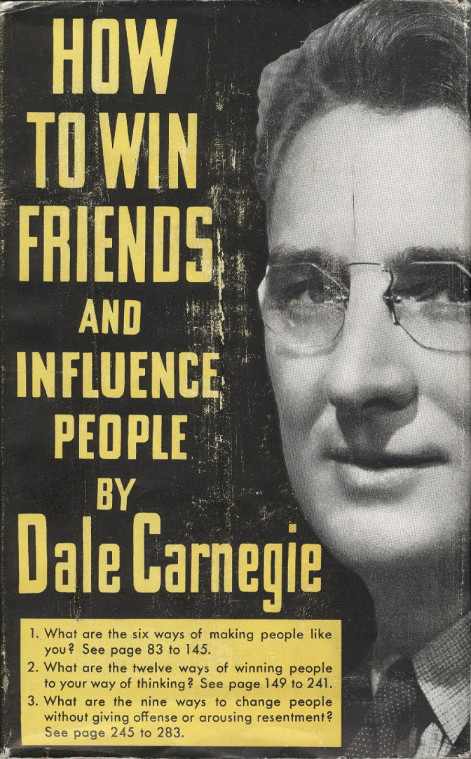
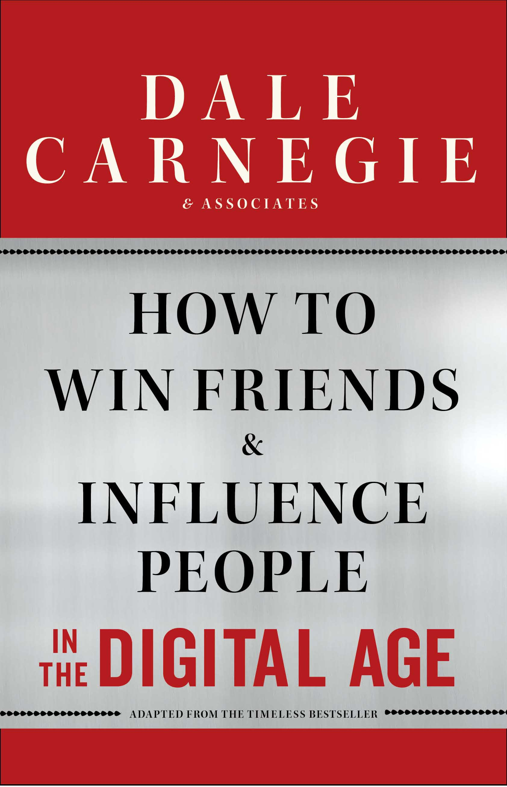
Igniting Workplace Enthusiasm Since 1912!

Slide 12
Dale Carnegie’s Relationship Pyramid
Desired Effect
Resentment
Opposite Effect
Influence Change
Enhance Teamwork
Connect with Others
Demonstrate Leadership
Change Attitudes & Behaviors
Compliance
Gain Cooperation
Create Accountability
Indifference
Strengthen Relationships
Build Trust
External Awareness

Slide 13
Memory Linking Exercise

Slide 14
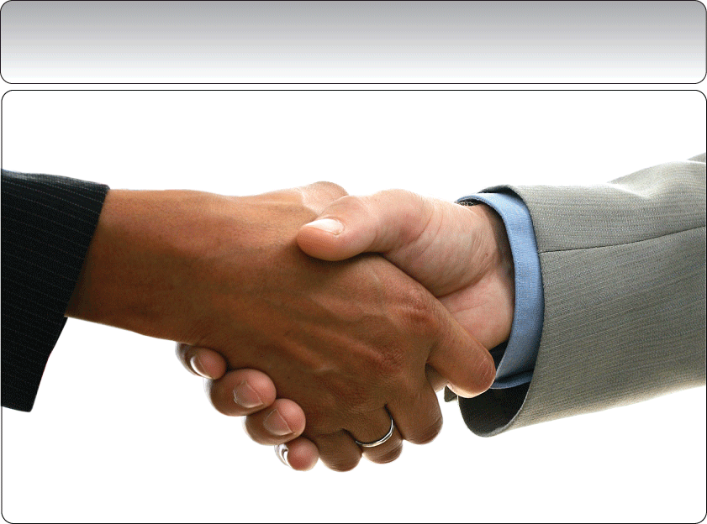
Connecting with Others:
Build Rapport Principles

Slide 15
Connect with Others: Principles for Strengthening Relationships
Don’t criticize, condemn, or complain
Give honest, sincere appreciation
Arouse in the other person an eager want
Become genuinely interested in the other person
Smile

Slide 16
Connect with Others: Principles for Strengthening Relationships
6. Remember that a person’s name is, to that person, the sweetest and most important sound in any language
7. Be a good listener. Encourage others to talk about themselves
8. Talk in terms of the other person’s interests
9. Make the other person feel important, and do it sincerely

Slide 17
Relationship Report: If I Could Have a “Do Over”

Slide 18
ISO-404-PD-EV-0745-V1.0

Slide 19
Contact Information
540.772.1723
Many free resources available
www.va.dalecarnegie.com

