Slide 1
Goodwill Industries® of the Valleys
You Donate & Shop. We Train. People Work.
.
Goodwill: One Local RESOURCE
for All Your Employment & Training Needs

Slide 2

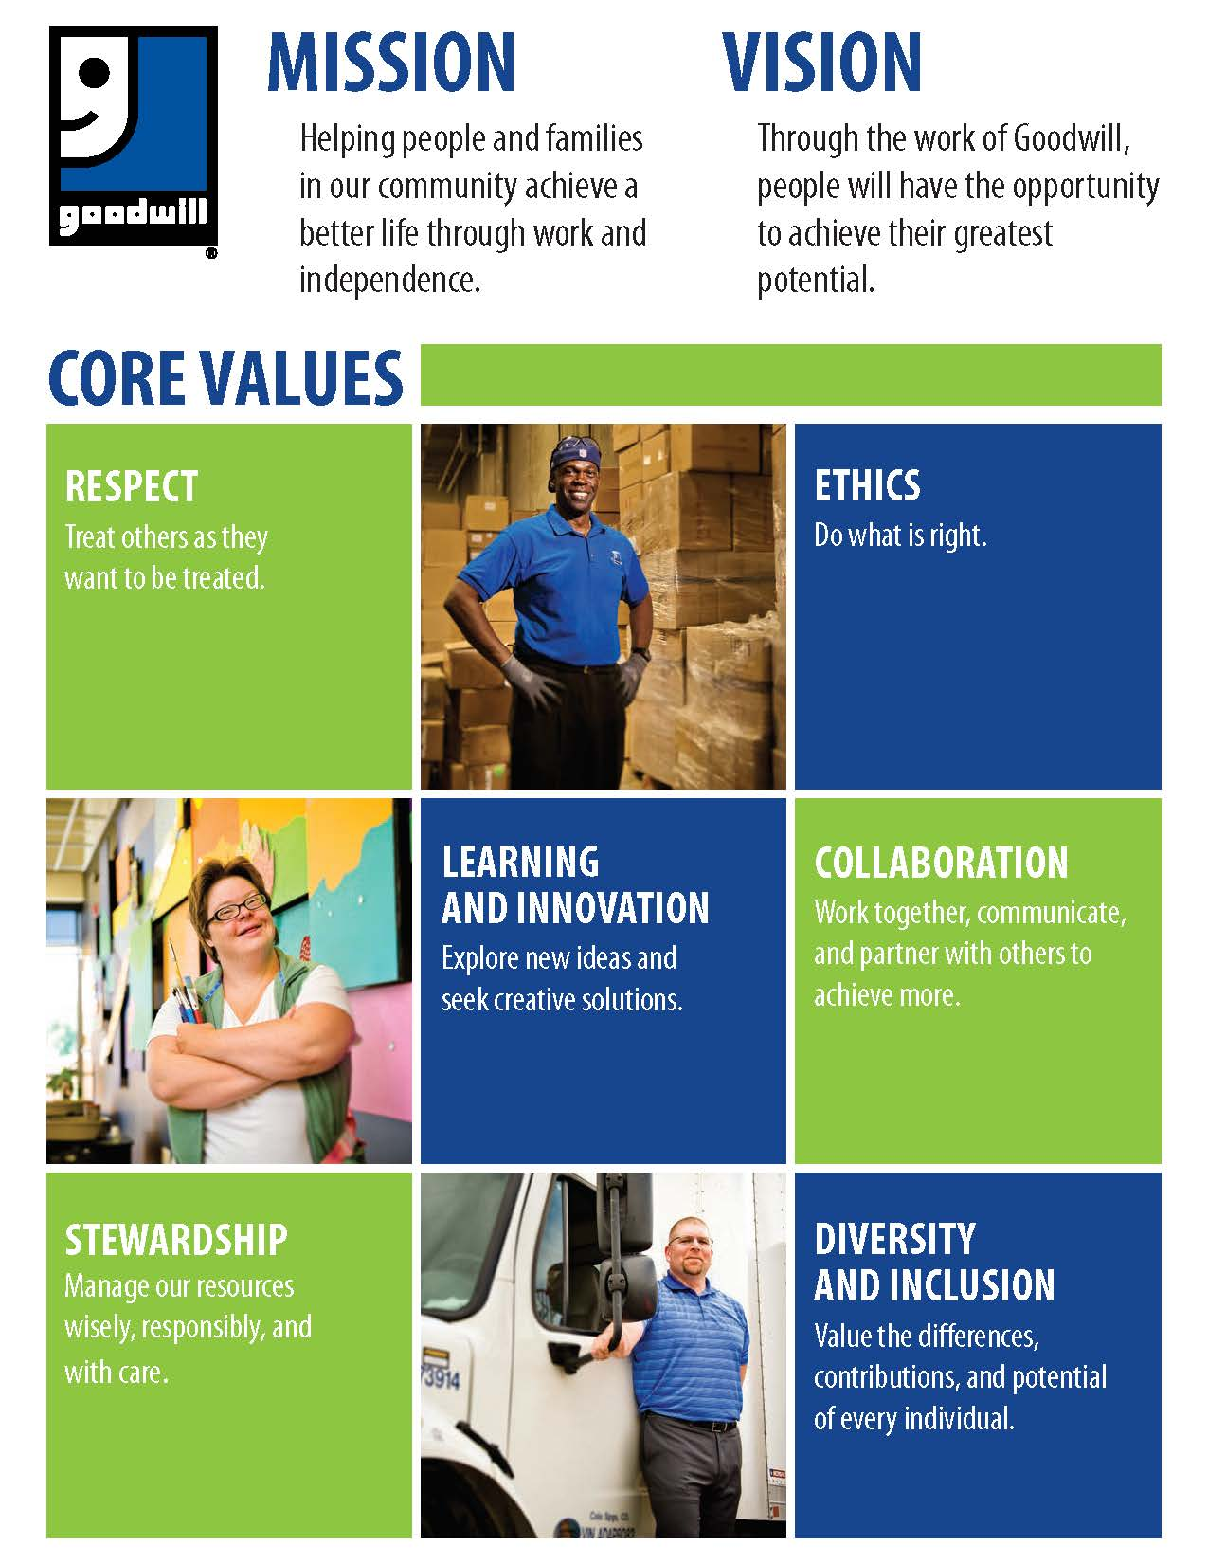
About Goodwill®
Goodwill was founded in 1902 by a Methodist Minister in Boston
157 Independent Goodwill organizations nationwide
Largest non-profit provider of training and employment programs to individuals with disabilities & disadvantages
Goodwill in Roanoke founded in 1931
42 Donated Good Stores
1100 employees
Mission Services, Support Services, Business Solutions, Donated Goods

Slide 3
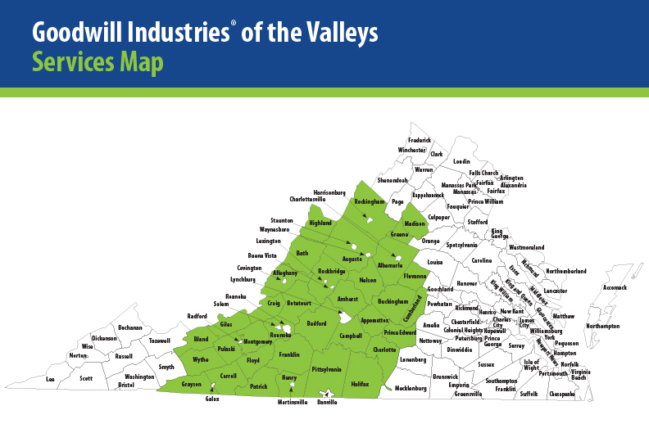
Goodwill Service Area in Virginia

Slide 4
Goodwill Economic Impact
  2018 Economic Impact of Goodwill Industries of the Valleys
  Individuals Served:
  Basic Career Services – 4,736
  Intensive Job Training, Employment and Youth Services - 840
  Individuals Placed in Employment – 247
  Industry Placements – Healthcare, IT, Manufacturing, Food Services, Retail, etc.

Slide 5
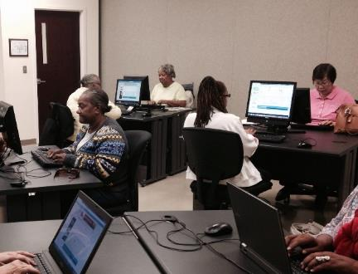
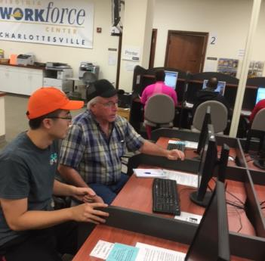
Who Benefits from Goodwill Services?
Services for the Public
The general public can benefit from basic Goodwill services such as:
  Computer Classes
  Career Development Workshops
  Job Search Assistance
  Job Fairs and Recruitment events
  Soft Skills Workshops
  And more

Slide 6

Who Benefits from Goodwill Services?
Business Solutions
Goodwill Can Assist Your Business With:
  Recruitment Solutions
  Staffing Solutions
  Credentialed & Customized Training
  Outsourcing Solutions
  Establishing Your Company as a Strong Community Partner
Recruitment • Training • Outsourcing

Slide 7
Who Benefits from Goodwill Services?
Services for Business
Recruitment Solutions:
  Suitability assessments
  Job support and retention services
  Connections to diverse candidates
  Meeting and interview space
  On-site recruitment assistance
A Local resource for All your Employment and Training Needs

Slide 8
Who Benefits from Goodwill Services?
Services for Business
Staffing Solutions:
  Direct hire or contracted employment
  On the job training, support and supervision
  Work experiences
  Paid internships*
A Local resource for All your Employment and Training Needs

Slide 9


Who Benefits from Goodwill Services?
Services for Individuals with barriers to employment
Youth, Adults, and Seniors who have barriers to finding a job or gaining greater independence benefit from Goodwill case managed services.
Barriers include:
  Disabilities
  Economic Disadvantages
  Those who have been laid off or lost their job due to company closing

Slide 10

Who Benefits from Goodwill Services?
Youth, Adult and Older Workers Services
  Goodwill Services includes:
  Career Services
  Career Navigation and Planning
  Education & Training Services

Slide 11


Training Services
Credentialed & Customized Training
Advance the Skills of Your Workforce
  Healthcare
  Technology Training
  Advanced Manufacturing
  Customer Service
  Digital Literacy
  Customized Training including:
    Soft skills
    Life skills

Slide 12
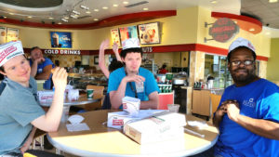
Training Services
Adult Services
  Healthcare Training
  GoodStart Prisoner Re-Entry Program
  Supported Employment
  TANF Support Services
  Jobs Plus
  Information Technology Training
  Medicaid Waiver

Slide 13

Training Services
HealthCare Training
  Provide education, training and supportive services
  3 Health Care Tracks:
    Nursing, Health Information, and Healthcare Support
  Advise individuals along healthcare career pathways that lead to higher levels of training

Slide 14


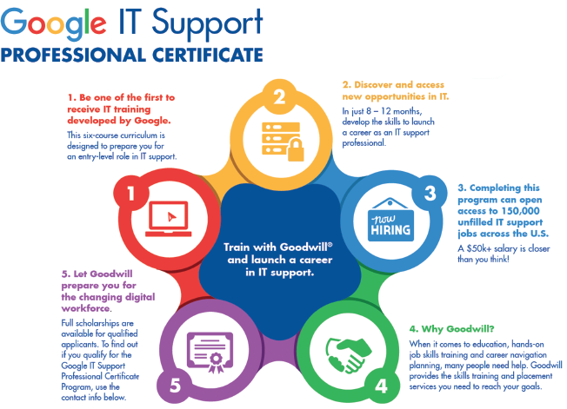
Training Services
Information Technology
  The Basics
    Computer Classes
  Intermediate Coursework
    Careers in Technology
  Advanced Coursework
    Google IT Support Professional Certificate

Slide 15
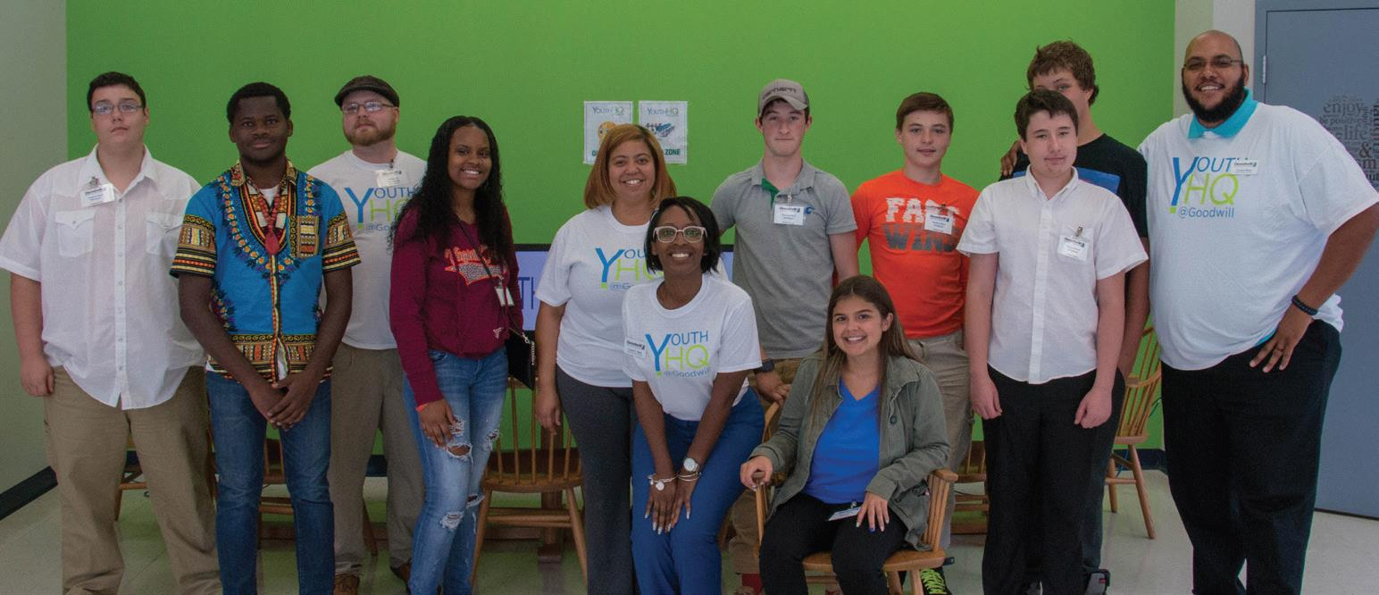
Training Services
Youth Services
  YouthHQ
  Pre-Employment Transition Services
  Project Search
  Science Club & Camp
  Youth Mentoring
  Youth to Work
    Goodwill Youth Programs: Building Tomorrow’s Workforce

Slide 16

Training Services
Older Worker Services
  Senior Community Service Employment Program (SCSEP)
  Part-time employment and training in community service positions
  Partner with a local non-profit organization (including local government and educational facilities).
  Individuals must be 55 and older and meet income guideline
The Goodwill Industries of the Valleys older worker program supports local businesses

Slide 17
Partnership Opportunities
  Work – Based Learning Opportunities
  Become a Mentor
  Mock Interviews
  Facility Tours
  Paid Internships
  Business Advisory Committees
  Direct Placement

Slide 18

Want to Know More?
Visit us online at www.goodwillvalleys.com
Take a Real Goodwill Tour – Tours are scheduled monthly. Space is limited so sign up today!

Slide 19
Questions?
Zenith Barrett, Senior Director of Business and Community Engagement
(540) 581.0620 | info@goodwillvalleys.com
Goodwill: One Local RESOURCE
for All Your Employment & Training Needs

Slide 20

BACK ON THE PATH

Slide 21
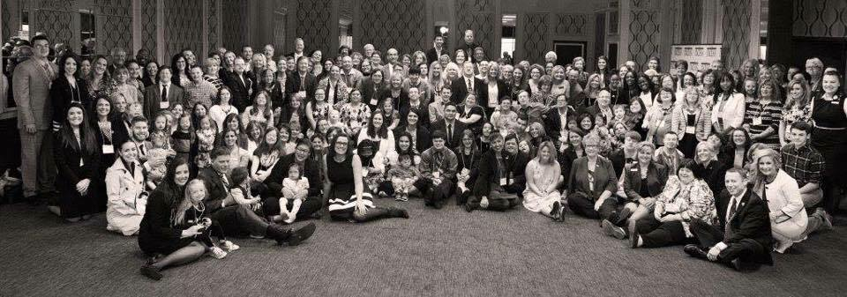

Ready, Willing and ABLE to Work!

Slide 22
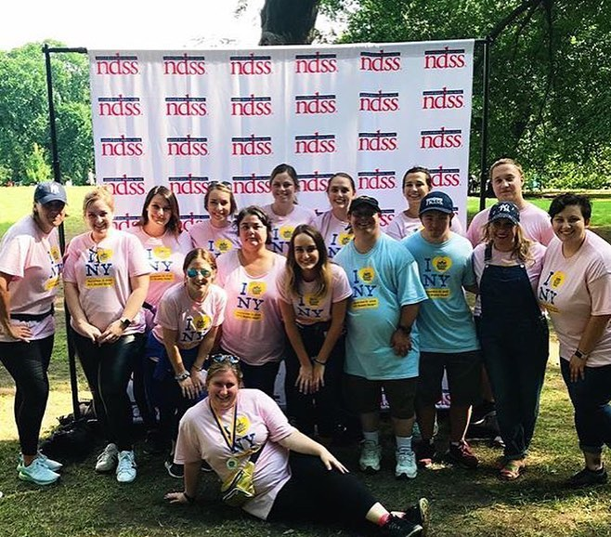
Who We Are
MISSION
The National Down Syndrome Society is the leading human rights organization for all individuals with Down syndrome.
VISION
The National Down Syndrome Society envisions a world in which all individuals with Down syndrome have the opportunity to enhance their quality of life, realize their life aspirations and become valued members of welcoming communities.

Slide 23
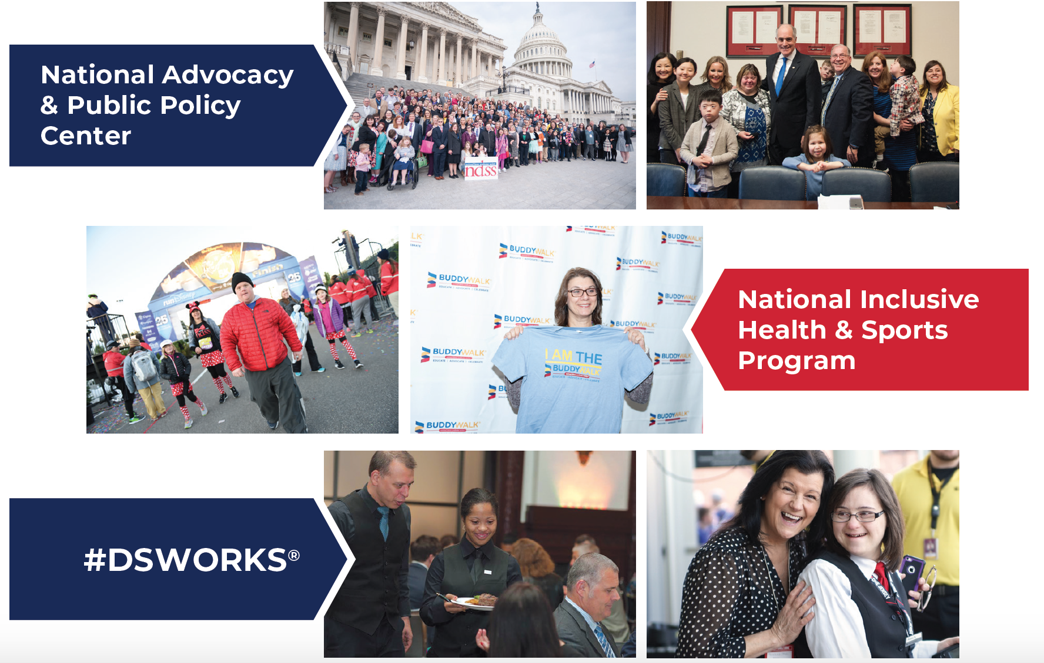
Health Promotion and Resources

Slide 24
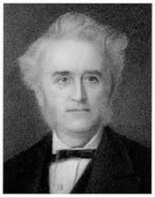
What is Down syndrome?
3rd copy of 21st Chromosome
Down syndrome is named for the English physician John Langdon Down, who characterized the condition, but did not have it
Down syndrome, rather than Down's syndrome
John Langdon Down
Notes:
While Down syndrome is listed in many dictionaries with both popular spellings (with or without an apostrophe s) the preferred usage in the United States is Down syndrome
Down Syndrome Facts: Simple
Typically developing people have 46 chromosomes …47 instead

Slide 25
Changing Images
Perceptions to Overcome | Perceptions to Develop
Child-like | Adult
Weak, ineffective | Strong, effective
Incapable of taking part in Self-Advocacy | Able to advocate
Incapable of pursing meaningful Careers | Ready, Willing & Able for inclusivity in the workplace
Trivial people who need to be entertained | Valuable people who contribute to society

Slide 26
Myths & Truths
Myths | Truths
Rare Disorder | 1 in 700/ 6,000 Births Yr.
Down syndrome = Born to older parents | Younger than 35
Lack of support | Parent support groups within communities
Severe cognitive disability | Not indicative of the many strengths and talents
Cannot be active member of community | Valued members of communities
Notes:
Myths & Truths, and a Preferred Language Guide. These tools can be accessed and printed from www.ndss.org. An employee with Down syndrome may or may not be comfortable talking about having Down syndrome. You could ask if he or she would like to talk about their different abilities as part of an introduction to the organization. If not, you might consider sharing this information with colleagues, keeping in mind that they may have questions. Educating staff members makes for better understanding, which makes for a more inclusive workplace.

Slide 27
Preferred Language
“Typically Developing” or “Typical” is preferred over “Normal”
“Intellectual Disability" or “Cognitive Disability” has replaced “Mental Retardation” as the appropriate term
People with Down syndrome should always be referred to as people first
Down syndrome is a condition or a syndrome, not a disease

Slide 28
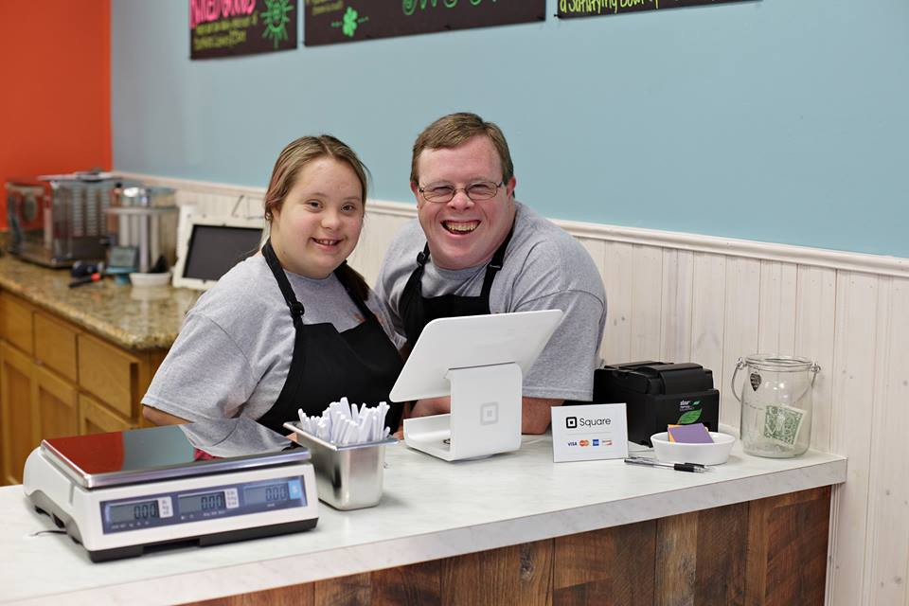
Expectations of Employees with Down syndrome
Be patient
Learn individuals strengths and weaknesses, and build upon them
Most of all, treat people with the same respect as any other co-worker

Slide 29

Tips For Positive
Communication
Keep a positive attitude
Be calm and understanding
Working with adults
Role model/Mentor
Treat as individuals
Serious approach to individual feelings and concerns

Slide 30
Things to Remember
Individuals with different abilities are people first
Individuals with different abilities are whole people
They expect to be treated with the same dignity and respect that you do
Just because someone has a disability does not mean he/she is disabled
Notes:
Do not underestimate someone with
different abilities.
Many people are capable of caring for themselves without any assistance. They’ve spent a long time adjusting to a different way of life.

Slide 31

What is #DSWORKS®?
Employment Resources
End #LawSyndrome
Employer Partnerships
Employment Training & Career Placement
Notes:
How we are going to accomplish it

Slide 32


#DSWORKS Employer Outreach
Corporate Partners
Small Business
C21
Sponsorships
Employer Roundtables
Outreach Strategy
  C21
  Employer Roundtables
  Self-Advocate Need
  Relationship & Networking Opportunities

Slide 33

How NDSS Supports Our #DSWORKS®
Partners
Technical Support
#DSWORKS® Scholarships
Training Opportunities
Professional Development
Marketing & Promotion
Corporate Partners
Small Business Partners
Strategic Partners
Notes:
partnership

Slide 34








#DSWORKS® Partnerships
Notes:
Partnerships - current

Slide 35
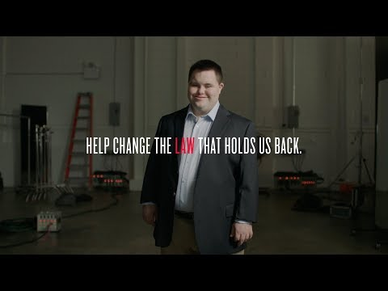
End #LawSyndrome

Slide 36
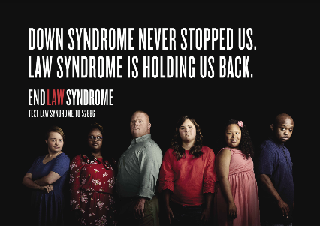
Why #LawSyndrome?
Outdated laws discourage all individuals with disabilities from fulfilling their potential
1 in 5 people in the United States have a disability.
The poverty rate for working-age people with disabilities is 22.3 percent higher than those without disabilities.
Despite the efforts of key civil rights laws, including the Americans with Disabilities Act and the Stephen Beck Jr., Achieving a Better Life Experience Act, individuals with Down syndrome still face barriers to living as full members of their communities.
Notes:
In October of 2017, NDSS launched our campaign to end #LawSyndrome. The premise of #LawSyndrome is that Down syndrome never stopped anyone, but rather old antiquated laws do. Laws like subminimum wage, where businesses can go to the department of labor and receive a special wage certificate that allows them to pay below minimum wage. Laws like the restrictive income limitations for Medicaid. Individuals with Down syndrome should be able to have meaningful careers without risking their benefits! The list of laws we’re trying to change goes on, but these statistics are evidence of just how damaging these laws are on this community.
Equal Pay for Equal Work
Maintain Benefits While Working
Marriage Equality
Access to Inclusion Across Grade Levels and School Settings
Promote Economic Self-Sufficiency

Slide 37
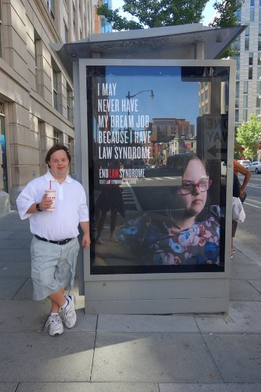
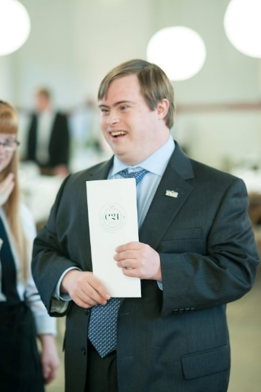
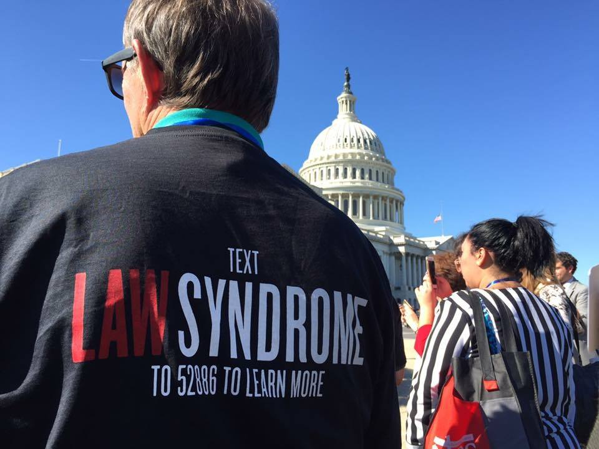
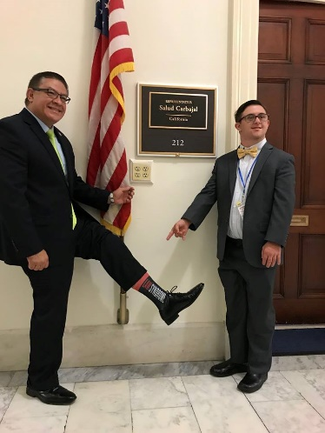
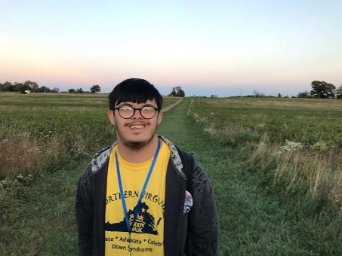
What is #LawSyndrome?
Law Syndrome is caused by a series of outdated laws that affects 100% of people with Down syndrome and other disabilities. It prevents them from pursuing a career and fulfilling their potential because of antiquated laws such as:
  subminimum wage
  restrictive Medicaid/SSI limitations
  marriage penalty
NDSS launched its End #LawSyndrome campaign in October 2017 during its C21 pop-up restaurant event.
  C21 is a restaurant hosted entirely by individuals with Down syndrome.
  NDSS has hosted 7 C21 events throughout the country- with more to come in 2020.

Slide 38
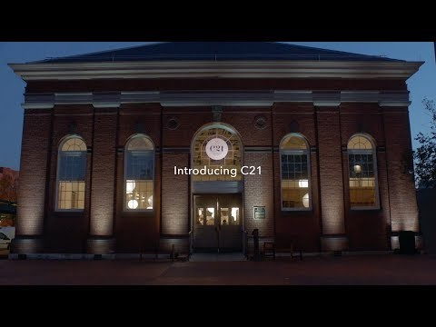
C21: A Unique Dining
Experience

Slide 39
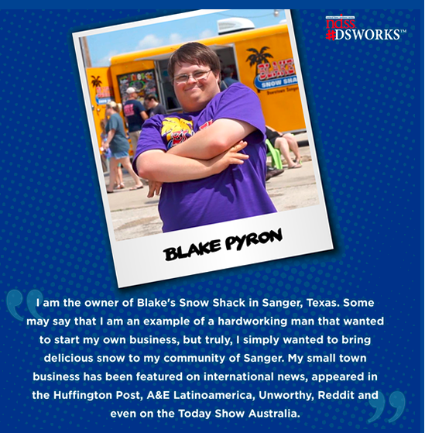
Subminimum Wage & the Transformation to Competitive Employment Act (H.R. 873/S. 260)
The goal of this legislation is to increase disability employment through expanding the infrastructure for providing services for competitive integrated employment and integrated services, while simultaneously phasing out Special Wage Certificates (SWCs) under Section 14(c) of the Fair Labor Standards Act.
    It is bipartisan legislation designed to strengthen and enhance the disability employment service delivery systems throughout the states.
The phase out period includes a systematic approach to expand capacity for competitive integrated employment, particularly for people transitioning out of sheltered workshops.
$300 million for three grants:
  Help states transition the business models of 14(c) certificate holders.
  Help current 14(c) certificate holders located in states that do not apply for the state grants to transition their business models.
  Assistance for providers who have withdrew their certificates to provide technical assistance to do the same.

Slide 40
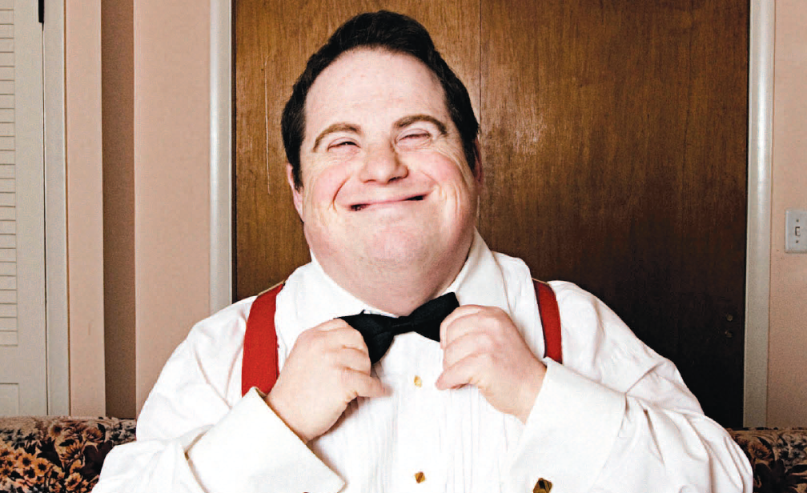
Get Involved with #DSWORKS®
Host or join an Employer Roundtable!
Share materials with NDSS!
Advocate for legislative agenda items!
Share an Employment Success Story!
Become a Strategic Partner!

Slide 41
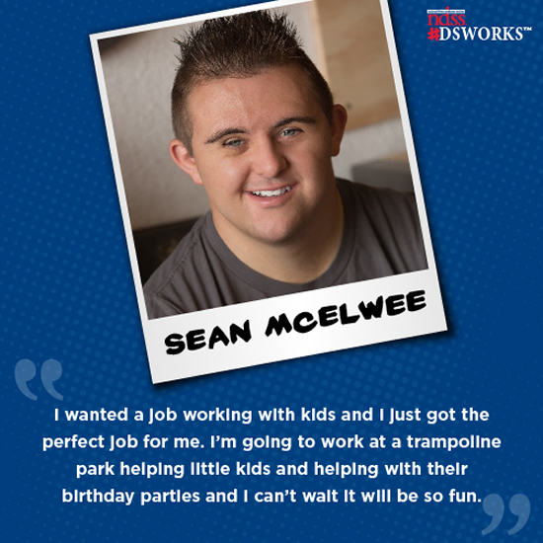
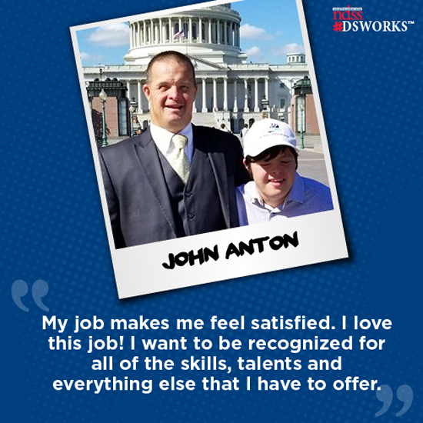
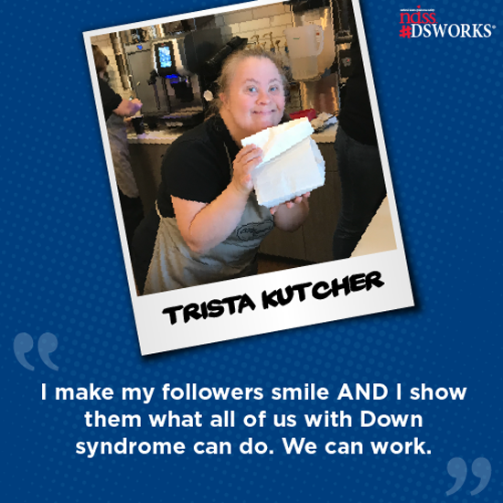
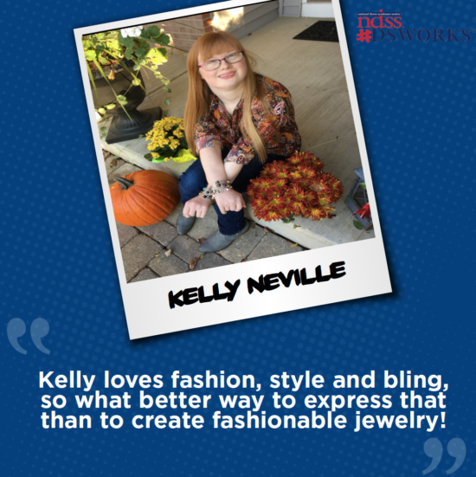

Ready, Willing and ABLE to Work!

Slide 42

NDSS 40th Anniversary Video

Slide 43
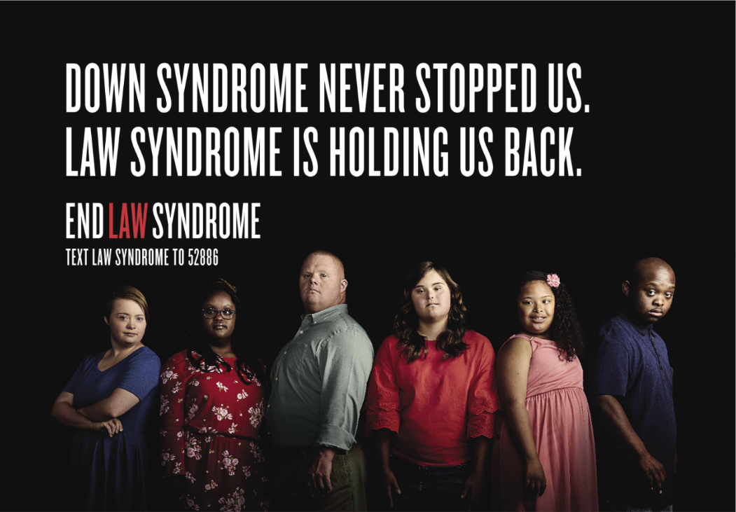

NDSS’ END #LawSyndrome Campaign
Text ‘Law Syndrome’ to 52886 and help us end #LawSyndrome!
Notes:
Equal Pay for Equal Work
Transitioning to Integrated, Meaningful Employment (TIME) Act (H.R. 1377)
The TIME Act will phase out Section 14(c) of the Fair Labor Standards Act, which allows entities who obtain a certificate from the Department of Labor to pay individuals with disabilities subminimum wage, over a period of six years.
Maintain Benefits While Working
Marriage Equality
Access to Inclusion Across Grade Levels and School Settings
Promote Economic Self-Sufficiency

Slide 44
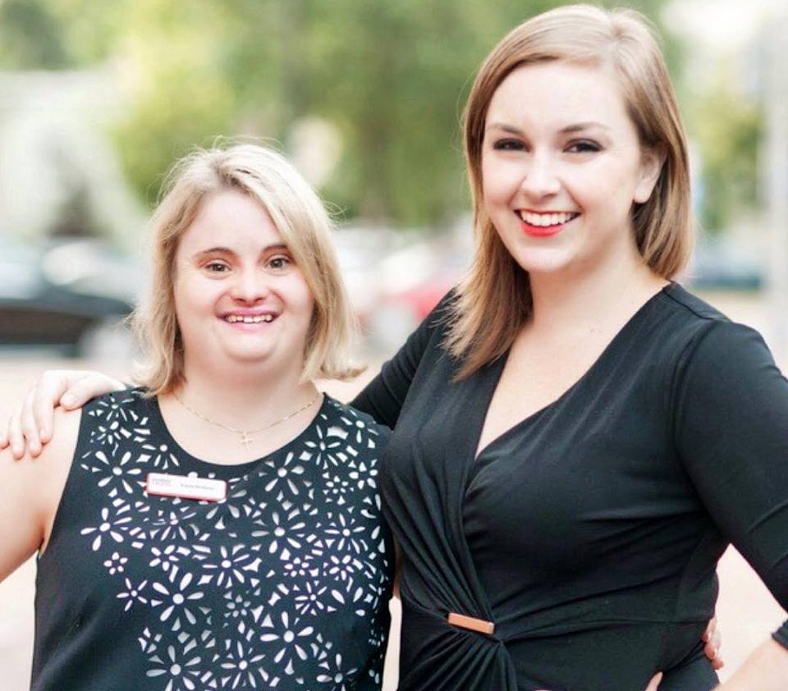
Ashley Helsing
Director of Government Relations
National Down Syndrome Society
202-766-2407
ahelsing@ndss.org

Slide 45
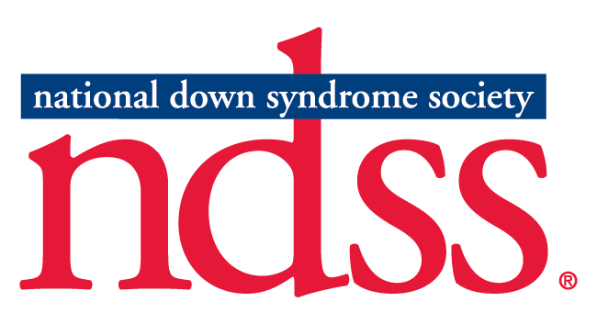
Thank You!
For questions or comments, please call 1 800-222-4602, email info@ndss.org or connect with us on social media.

